Slide 1
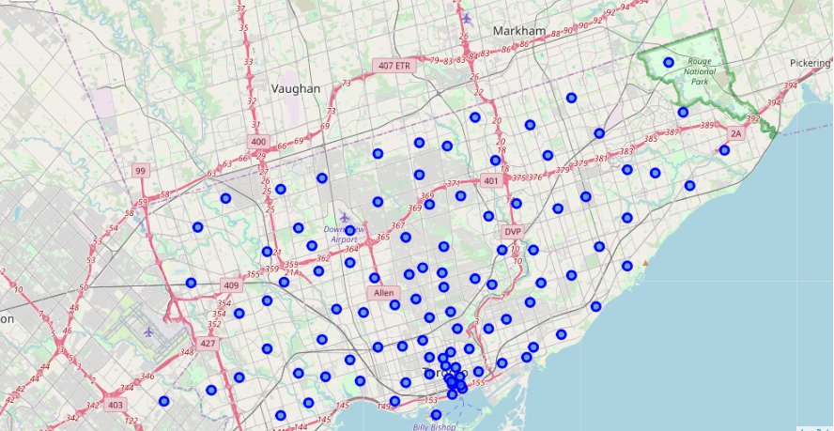
Best place for a Summer trip in Central Toronto

Slide 2

Business problem
A travel agent conducted a survey to help them plan a trip for a group of students from Stellenbosch University to visit Toronto. In the survey, the agent asked the students what facilities and activities they’d like to do while in Canada. The results in the survey showed that the students prefer to stay in Central Toronto.
The agent then sent results of the survey to our consulting company (StervAI) to analyse the results and recommend boroughs to get the students accommodation in Central Toronto

Slide 3
Data requirements
The data required for this project include:
Geo-coordinates for the recreational activities, amenities and facilities gathered by the travel agent in the survey
Geo-coordinates for borough and neighborhoods in Central Toronto
locational information about that specific borough and the neighborhoods in that borough
We assume it is "Scarborough" in Toronto. This is easily provided for us by the contractor, because the contractor has already made up his mind about the borough.

